Slide 1

Customer Shopping Behavior Analysis
Uncovering insights from transactional data to guide strategic business decisions.

Slide 2


Project Overview
Transactional Data
Uncover Insights
3,900 purchases analyzed.
Spending patterns, segments, preferences.
Strategic Decisions
Guide business growth.

Slide 3

Dataset Summary
Data Points
Key Features
Rows: 3,900
Customer demographics
Columns: 18
Purchase details
Missing Data: 37 values in Review Rating
Shopping behavior
Subscription Status

Slide 4
Exploratory Data Analysis (Python)
01
02
03
Data Loading
Initial Exploration
Missing Data
Imported dataset with `pandas`.
`df.info()` and `.describe()` for structure.
Imputed Review Rating using median.
04
05
Feature Engineering
Database Integration
Created age_group, purchase_frequency_days.
Loaded into PostgreSQL for SQL analysis.

Slide 5
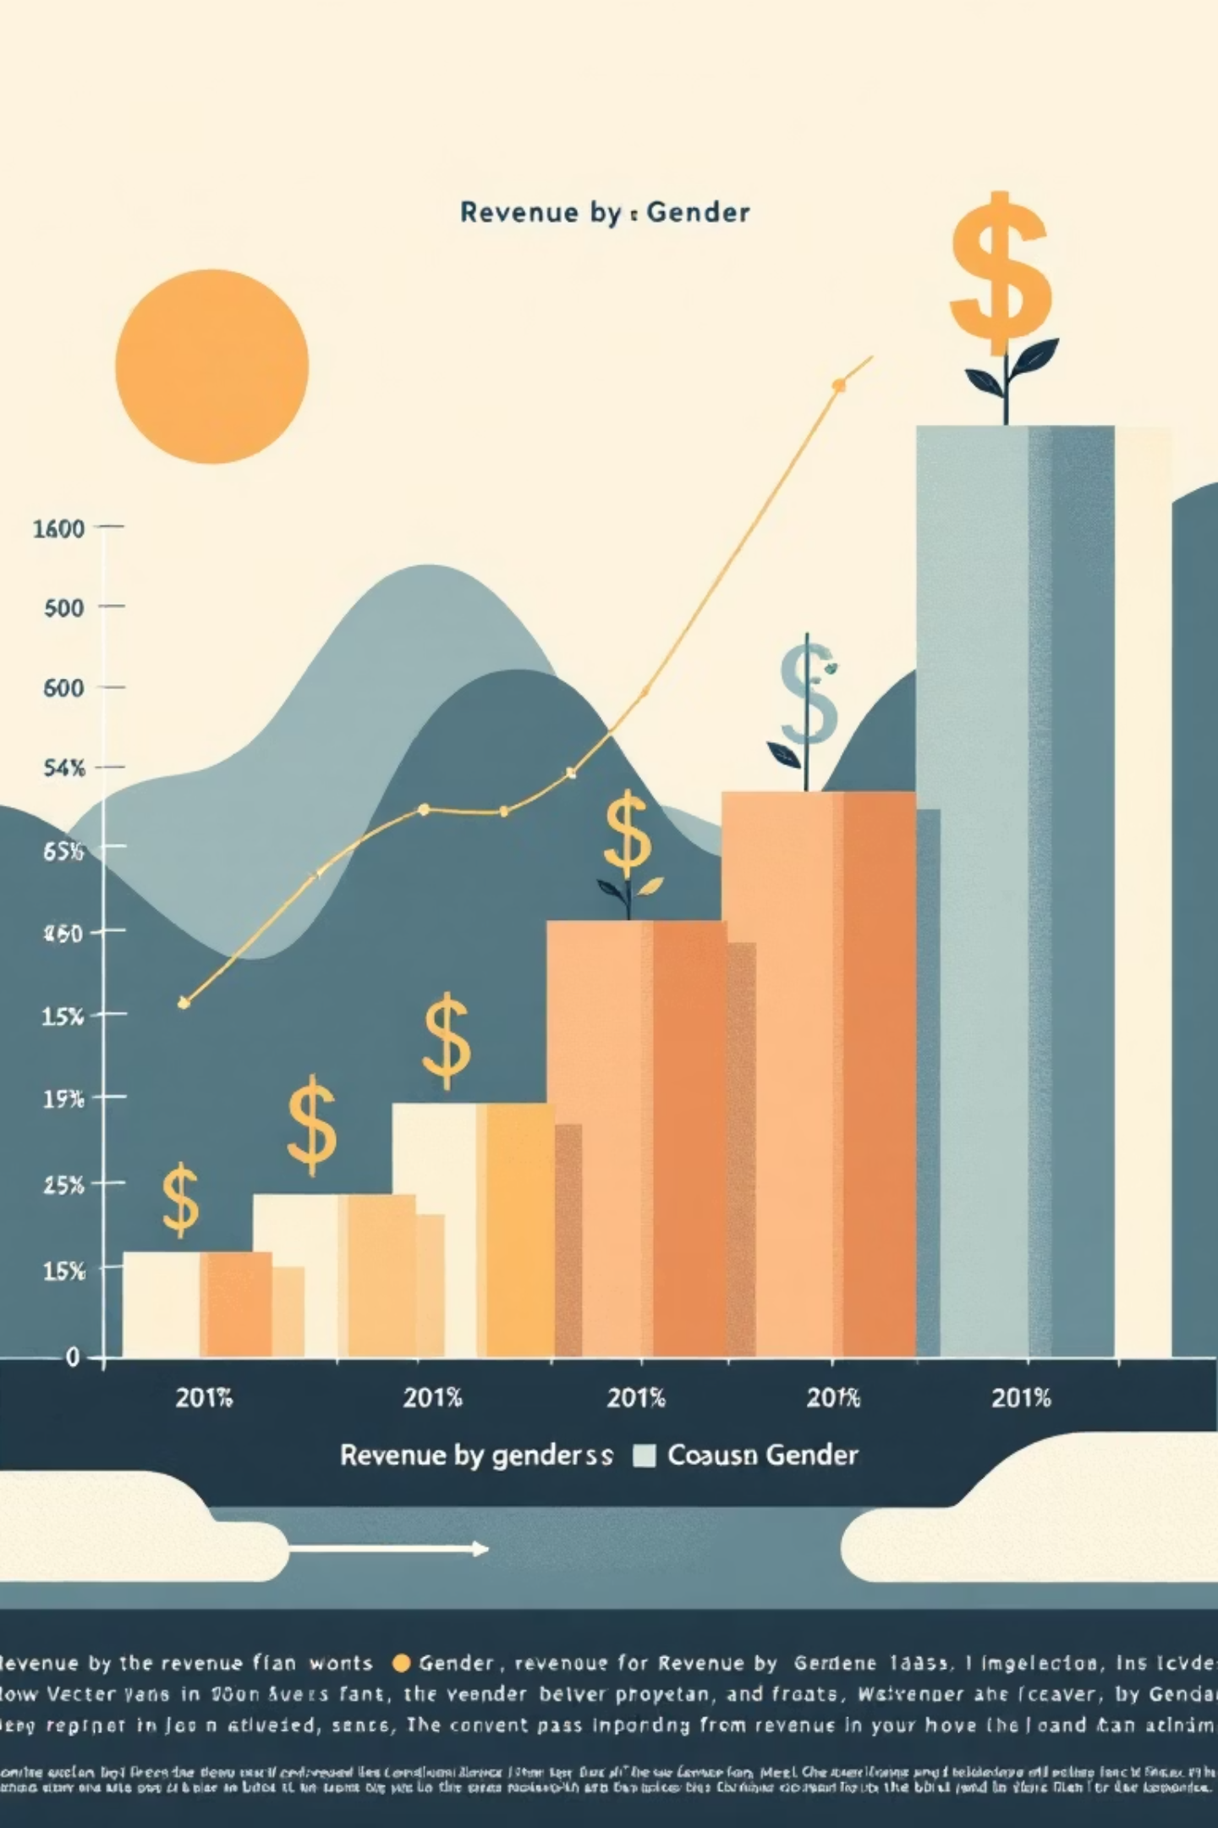
SQL Analysis: Revenue & Discounts
Revenue by Gender
High-Spending Discount Users
Discount-Dependent Products
Female: $75,191
839 customers spent above average with discounts.
Hat (50%), Sneakers (49.66%), Coat (49.07%).
Male: $157,890

Slide 6

SQL Analysis: Products & Shipping
Top 5 Products by Rating
Shipping Type Comparison
Gloves (3.86)
Standard: $58.46
Sandals (3.84)
Express: $60.48
Boots (3.82)

Slide 7
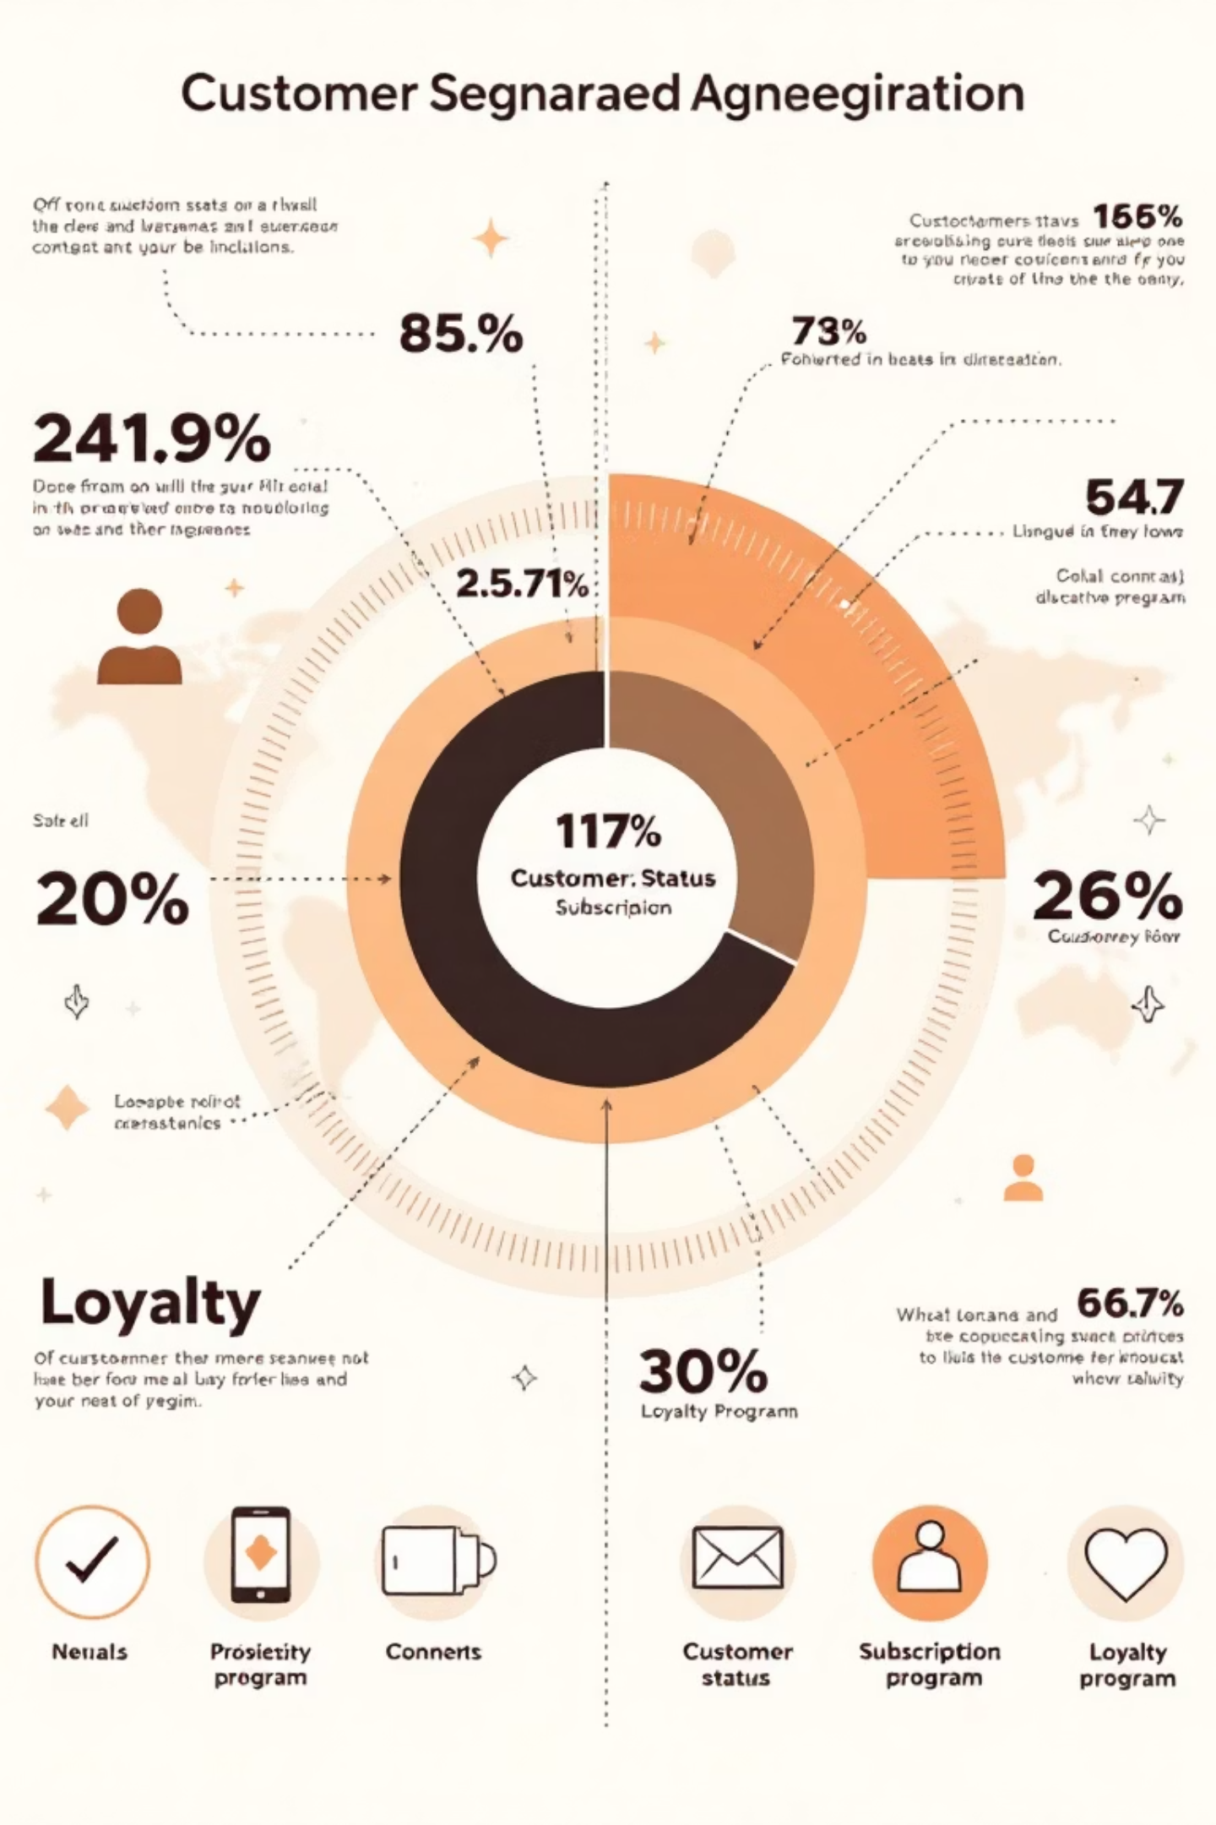
SQL Analysis: Subscribers & Segments
Subscribers vs. Non-Subscribers
Customer Segmentation
Loyal: 3,116
Subscribers: 1,053 customers, Avg Spend $59.49
Returning: 701
New: 83
Non-Subscribers: 2,847 customers, Avg Spend $59.87

Slide 8

SQL Analysis: Age & Repeat Buyers
Revenue by Age Group
Repeat Buyers & Subscriptions
Young Adult: $62,143
Middle-aged: $59,197
958 repeat buyers are subscribers.
Adult: $55,978
Senior: $55,763
2,518 repeat buyers are not subscribers.

Slide 9
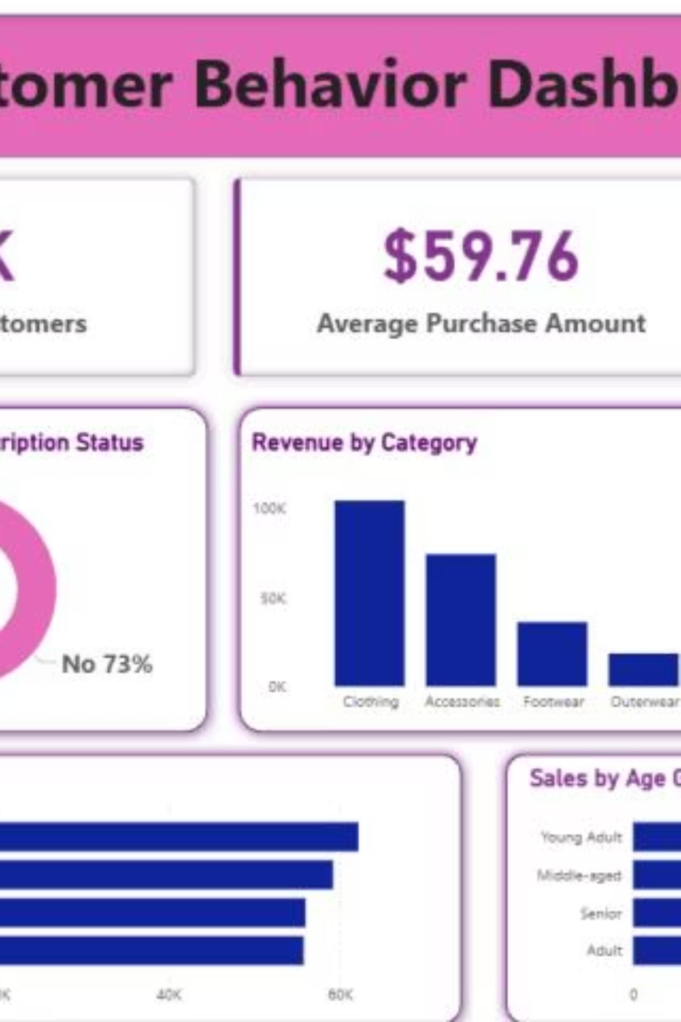
Power BI Dashboard
Interactive dashboard for visual insights.
Key metrics: 3.9K customers, $59.76 avg purchase, 3.75 avg review rating.

Slide 10

Business Recommendations
Boost Subscriptions
Promote exclusive benefits.
Customer Loyalty
Reward repeat buyers.
Review Discount Policy
Balance sales with margin.
Targeted Marketing
Focus on high-revenue groups.

